Slide 1
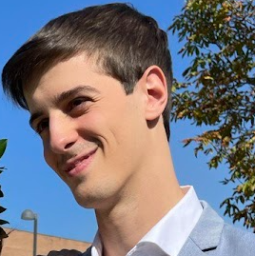




MARCHETTI EDOARDO
Football and Data enthusiastic | Master student @Politecnico di Torino
Personal Info
DoB : 20/08/1999, Perugia, IT
Living in: Fratta Todina, Perugia, IT
Driver Lincense: B
ACADEMIC STUDIES:
2018-2021: Degree in computer and electronic engineering, (V 110L/110)
2021-2023: Master Degree in Data Science and Engineering, (xV 110/110)
Work Experiencies:
2023 Aug-: Asd Tiber, video analyst
2023 Jan-Jun: Gymnasio, 6 months intern as data scientist, activity recognition with skeleton data and GCN.
Contacts & Social
Email : edoardomarchetti2@gmail.com
Cell: +39 3665345357

Slide 2











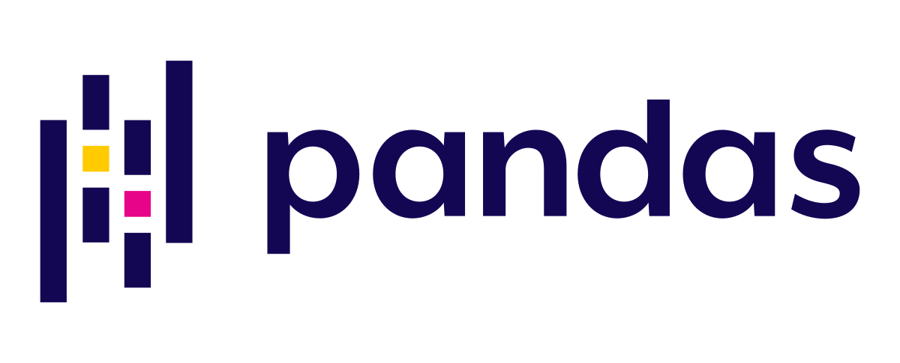




HARD SKILLS

Slide 3
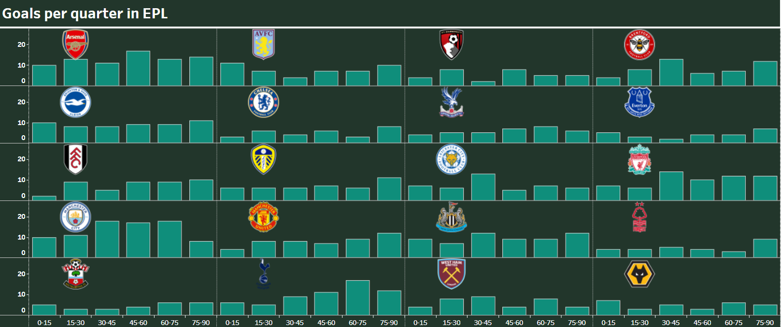
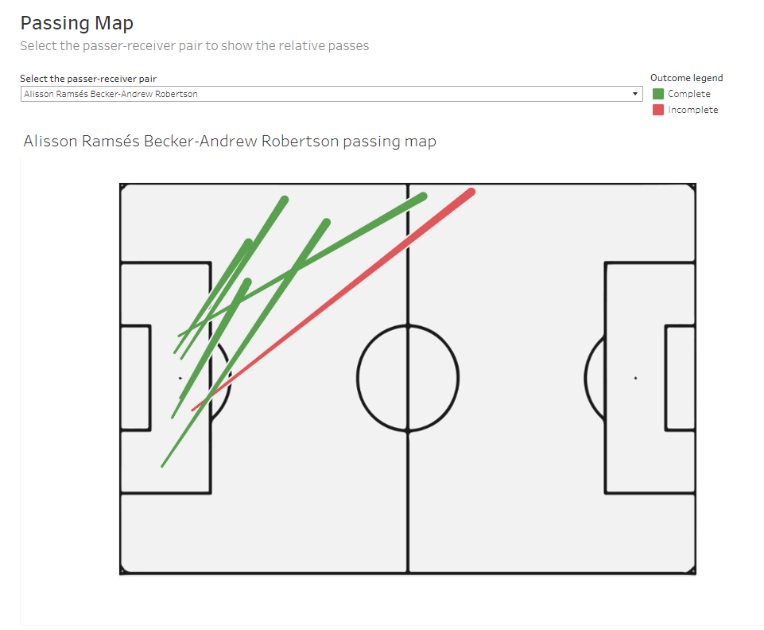
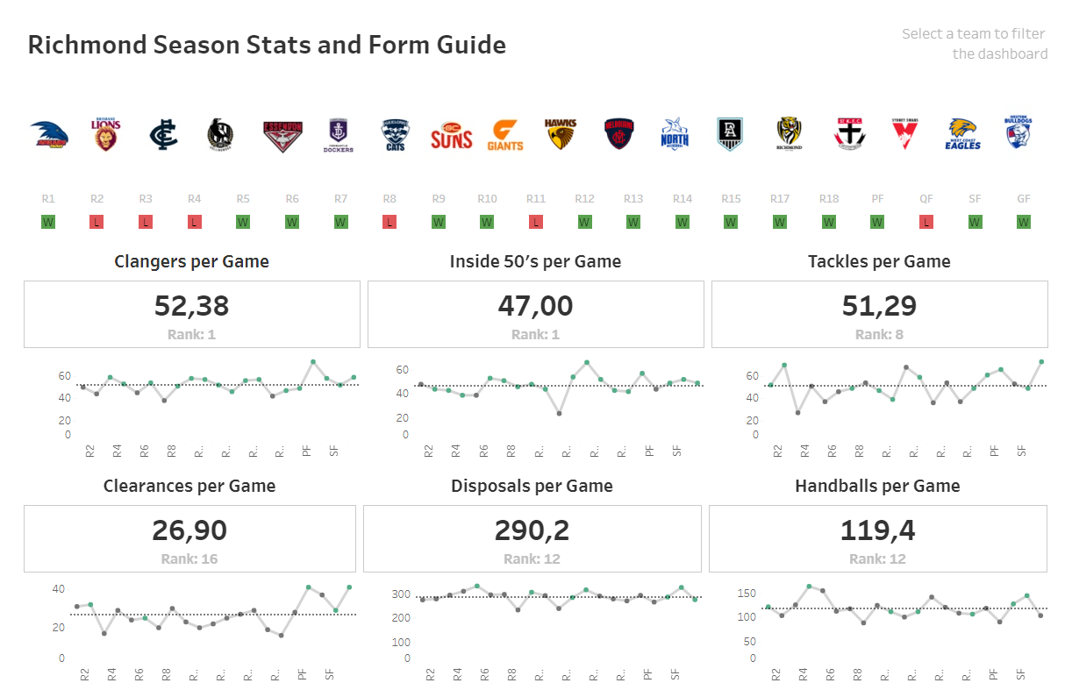
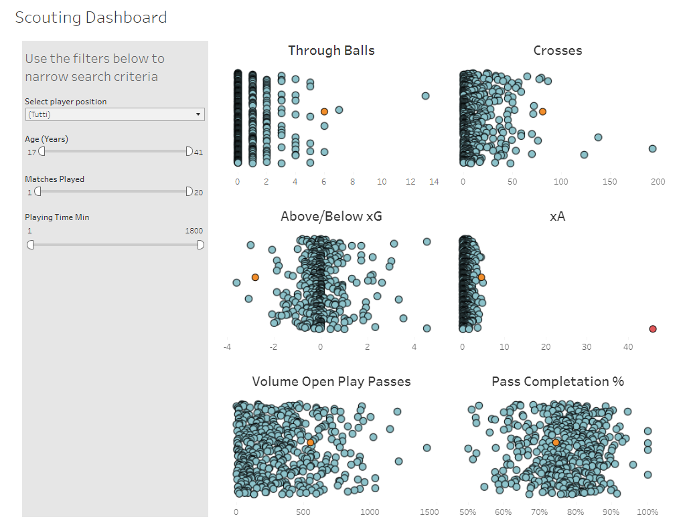
FOOTBALL ANALYS DASHBOARDS
Following the video tutorial made by Rob Carroll, I created some dashboards to analyze different aspects of football matches or complete seasons. You can find all the dashboards in my Tableau public account.

Slide 4
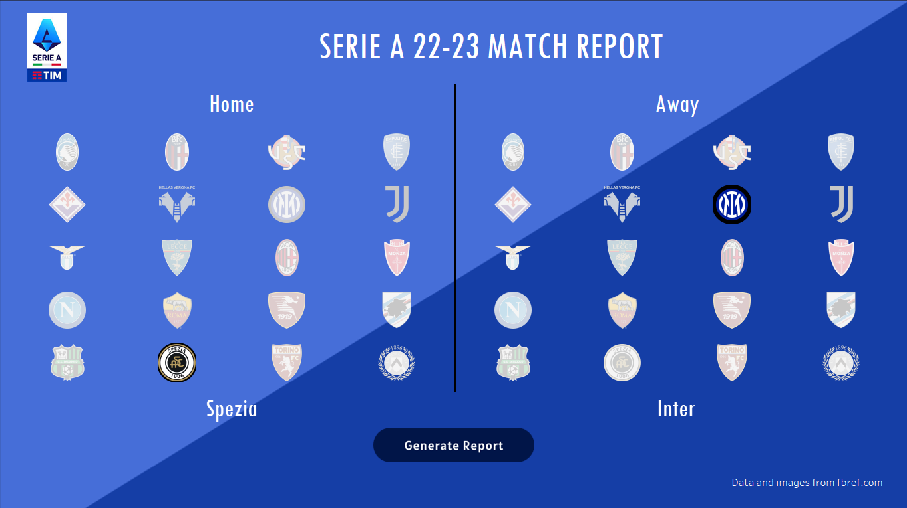

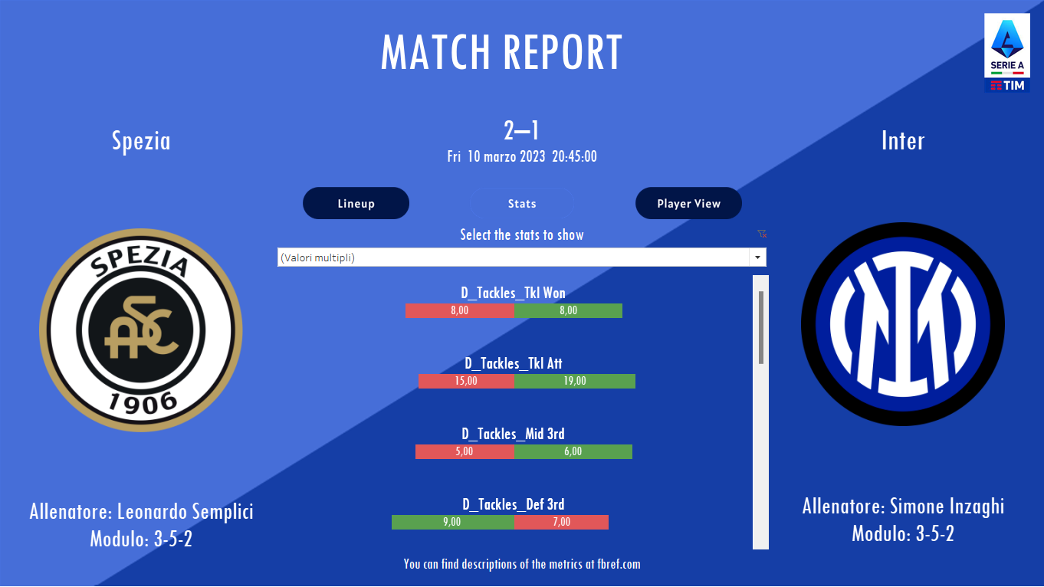
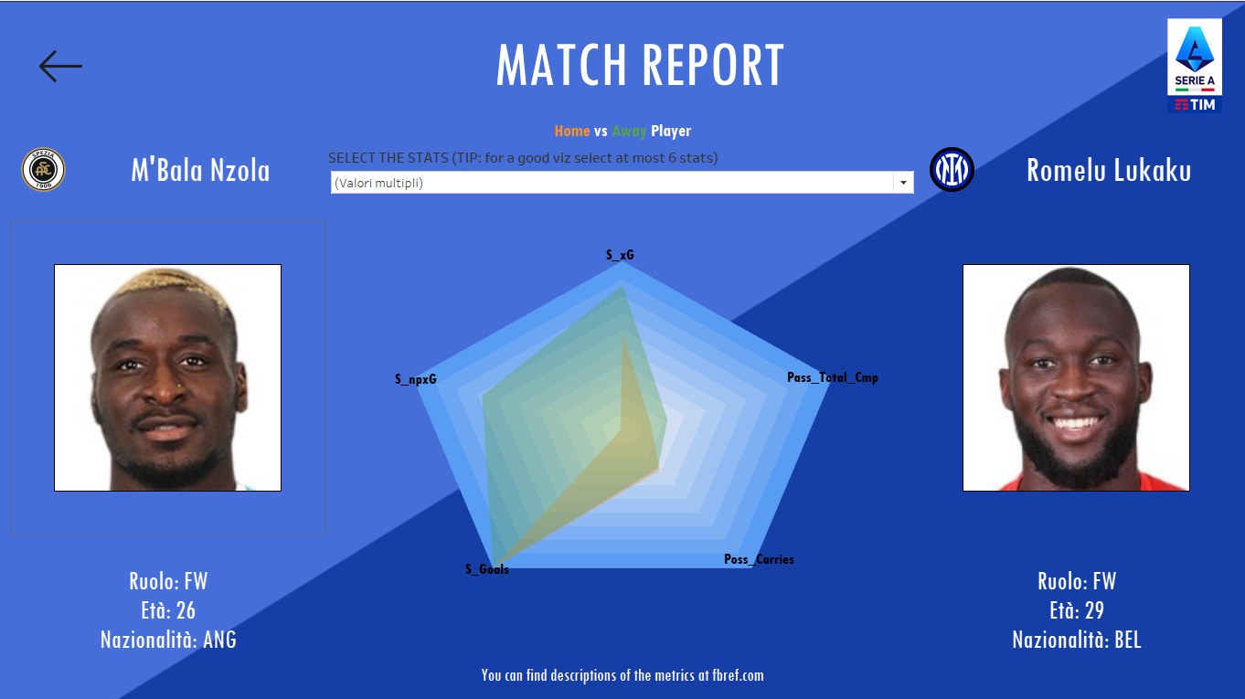
MATCH REPORT GENERATOR
This dashboard, created for the Data Visualization for Football Data Analyst course delivered by Wylab, allows the user to select a match from the 22/23 Serie A season and compare the performance of teams and players.
Using Python and the libraries beautiful soup and pandas, I was able to scrap data from the fbref.com website. Once I reorganized the statistics of all the matches, I imported the tables into Tableau where I built the user interface, a bar chart to compare the performance of the teams, and a radar chart to compare the performance of the players within the match. The user can decide which metrics to examine and which players to compare. In addition, it is possible to view the starting line-ups of the two teams as well as additional match info such as result, time, coaches, and modules used.
See the code and the dashboard here:

Slide 5



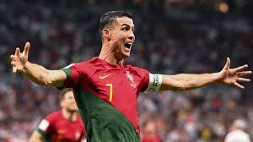
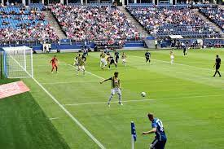
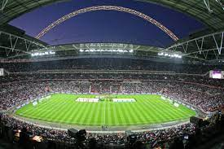



AUTO-HIGHLIGHTS FOR AMATEUR TEAMS
(in progress)
This year I volunteered to be a video analyst for my hometown team, Asd Tiber. Playing in a non-professional category and not being able to afford ready-to-use video analysis software, the process of analyzing the match and creating highlights is very time-consuming. That is why I decided to create software that allows me to automatically identify the key moments of the match based on timestamp, type of action, and dangerousness.
During the recording of the match, I make voice notes with specific prompts such as: 'time [min] [sec] action [action type] dangerousness [value]'. In the post-match, I pass the audio tracks to the IBM Watson speech-to-text model. Finally using the timestamp saved in the audio I can go and cut the relevant clip within the video. Finally, I upload the video on a YT channel to share them with the team.
The whole process is therefore easy, adaptable, and low-cost: all you need is a camera, a recorder, and an IBM Cloud account with the Lite plan (500 minutes per month of audio to convert).

Slide 6
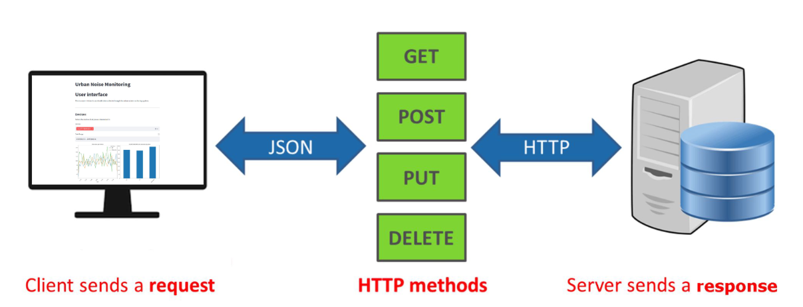
REAL-TIME URBAN NOISE DETECTION
I know what you are going to say: 'What does urban noise detection have to do with football?' Well, not much.😅
However, I also included this project because I think it can be easily adapted to football, in particular to the real-time monitoring of players' physical data. In fact, for the Machine Learning for IoT exam, I had to implement an urban noise monitoring system whose results were saved in real time on Redis via a publisher-subscriber system. After that, the user can monitor the readings via a web app developed in streamlit thanks to a Rest API.
A similar infrastructure could be realized to collect and analyze timeseries concerning the physical performance of players during training.
Here you can find the project and the relative ppt:

Slide 7
WHAT’S NEXT?
To buy or not to buy? Implementation of a dashboard in Tableau to evaluate and compare the players of a fantasy football league.
(next weeks)
UI for AHFAT
Realize a user interface to use the automatic highlights generator, leaving it for non-coding users to use.
(next 1-2 months)
Pressing Analysis Development of a GCN-based deep learning model to analyze and identify the pressing style and effectiveness of teams. Starting from the positions of the players on the field, the model must be able to predict the probability of recovering the ball within a certain period of time.
(start in 2024, after the thesis)

Slide 8

That’s all from here.
For more info or any feedback just contact me.
edoardomarchetti2@gmail.com
+39 3665345357

